Slide 1
Chapter 8
Dealing with State in React

Slide 2
Objectives
Using State
Our Starting Point
Getting Our Counter On
Setting the Initial State Value
Starting Our Timer and Setting State
Rendering the State Change

Slide 3

Using State
Lightning strikes Earth’s surface about 100 times a second, according to National Geographic. We have a counter that simply increments a number you see by that same amount.

Slide 4
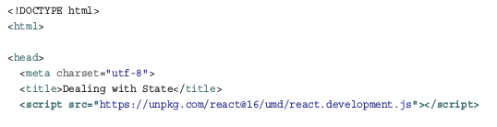
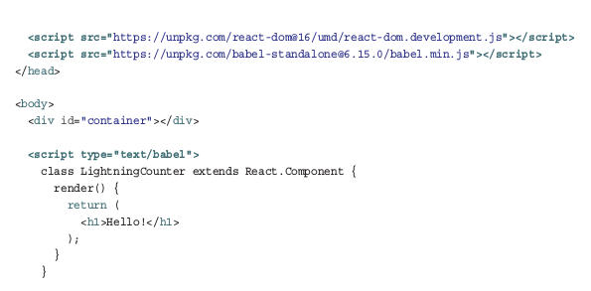
Our Starting Point

Slide 5
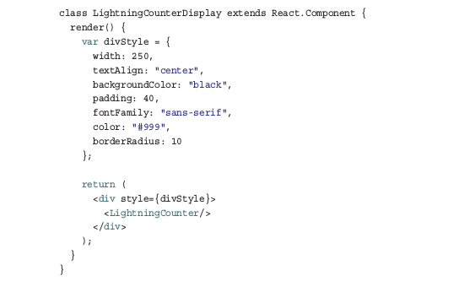
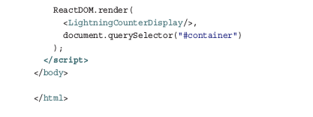
Our Starting Point

Slide 6
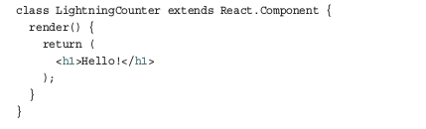

Our Starting Point
The LightningCounter component is where all the action will take place:
The last thing to look at is our ReactDOM.render method:

Slide 7
Getting Our Counter On
To make this all work, we’re relying on three APIs that our React component exposes:
componentDidMount
This method gets called just after our component gets rendered (or mounted, as React calls it).
setState
This method allows you to update the value of the state object.

Slide 8
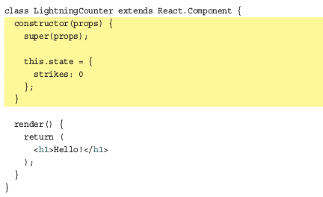
Setting the Initial State Value
We want to create a state object, make our strikes variable a property of it, and ensure that we set all of this up when our component is getting created.

Slide 9

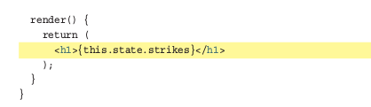
Setting the Initial State Value
It looks something like the following:
Before we wrap up this section up, let’s visualize our strikes property. In our render method, make the following highlighted change

Slide 10
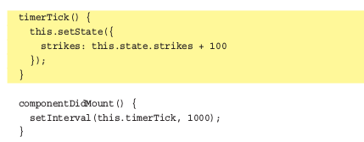
Starting Our Timer and Setting State
Change states with method setState
Inside our componentDidMount method that gets called after our component gets rendered, we have our setInterval method that calls a timerTick function every second (or 1000 milliseconds).

Slide 11
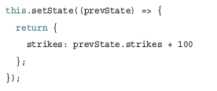
Starting Our Timer and Setting State
Note: Incrementing the Existing State Value
React might decide to batch state updates in rapid succession. This could lead to the original value stored by this.state to be out-of-sync with reality.
The setState method gives you access to the previous state object via the prevState argument.

Slide 12
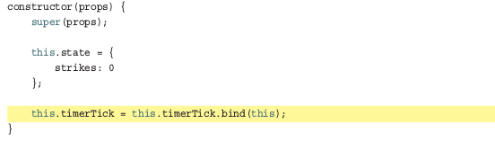
Starting Our Timer and Setting State
The timerTick function has been added to our component, but its contents don’t have their context set to our component. In other words, the this keyword where we are accessing setState will return a TypeError in the current situation.

Slide 13

Rendering the State Change
Whenever you call setState and update something in the state object, your component’s render method gets automatically called. This kicks off a cascade of render calls for any component whose output is also affected.

Slide 14
Optional: The Full Code
Pages 95-97

Slide 15
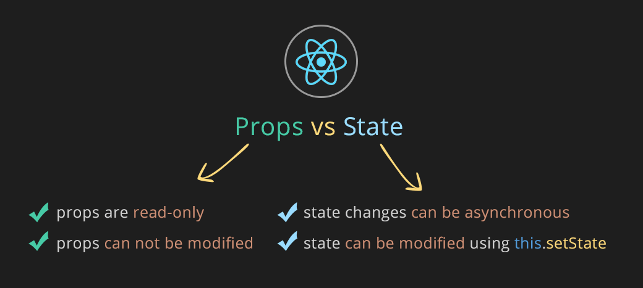
Properties versus states in ReactJS
Properties are declared when React component are created, while states are declared within the component definitions.

Slide 16
Conclusion
While using a timer to update something in our state object is cool, the real action happens when we start combining user interaction with state.
So far, we’ve shied away from the large amount of mouse, touch, keyboard, and other related things that your components will come into contact with.
Along the way, you’ll see us taking what we’ve seen about states to a whole new level. If that doesn’t excite you, then I don’t know what will.

